Slide 1
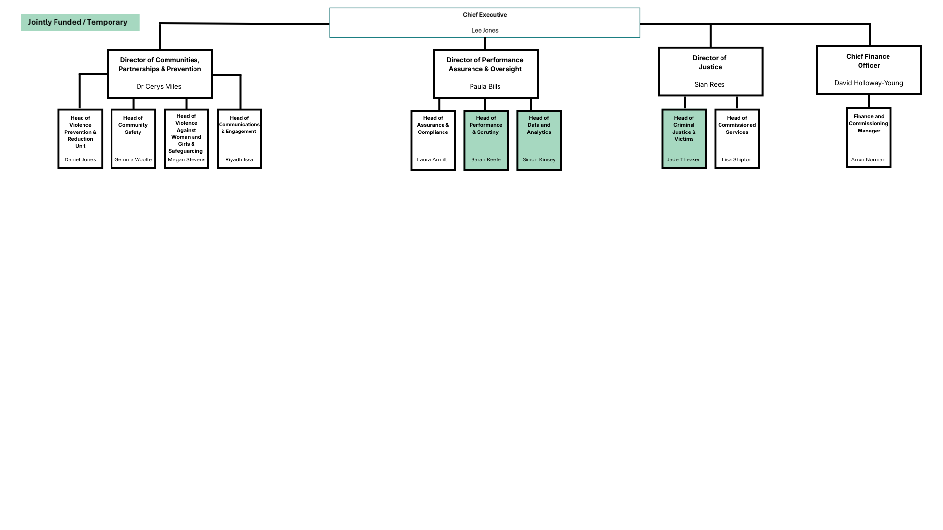

Communities, Partnerships and Prevention
1 | Senior Policy Officer
1 | Violence Prevention Communications and Engagement Officer
1 | Engagement Manager | 0.6 | Engagement Support Officer
 |  | 0 | Engagement Support Officer
1 | Policy Officer
0 | Violence Prevention Data and Insights Officer
0 | Administrative Support Officer
2 | Blueprint Project Delivery Manager – VAWDASV
1 | Project and Policy Support Officer (VAWDASV)
1 | Policy Officer
0 | Policy and Project Support Officer
Performance, Assurance and Oversight
1 | Staff Officer
1 | Senior Executive Advisor and Support Officer
1 | All Wales Executive Support Officer
1 | Principal Analyst
1 | Policy Officer
1 | Business Coordinator | 2 | Personal Assistant
 |  | 3 | Administrative Assistant
1 | Assurance and Compliance Senior Officer | 2 | Assurance and Compliance Support Officer
 |  | 1 | Assurance and Compliance Administration Support Officer
 |  | 0.8 | Assurance and Compliance Review Officer
Justice
1 | Senior Lead for Criminal Justice Anti-Racism (All Wales) -
1 | Anti Racism Project Manager (All Wales)
1 | Senior Policy Officer
4 | Policy Officer
3 | Policy and Project Support Officer
Finance
1 | Commissioning and Grants Funding Officer
1.5 | Finance and Grants Support Officer
Living Wage: The Police and Crime Commissioner for South Wales, believes that paying the independently calculated Living Wage is a key indicator of an employer’s commitment to their workforce. That is why the Commissioner has agreed with the Chief Constable that all of their staff will be paid the independently calculated Living Wage as a minimum. We will also encourage our partners, contractors, and suppliers to pay the same Living Wage to their staff, wherever practicable.

